Slide 1
Exploratory Analysis of Contact Strategies for Annual Economic Surveys
By Hannah Wen and Katharyn Loweth
Mentors: Melissa Cidade and Stephen Cox
Economy-Wide Statistical Division
August 2024
Any opinions and conclusions expressed herein are those of the author(s) and do not reflect the views of the U.S. Census Bureau. The Census Bureau has reviewed this data product to ensure appropriate access, use, and disclosure avoidance protection of the confidential source data (Project No. P-7529180, Disclosure Review Board (DRB) approval number: CBDRB-FY24-EWD001-004).
Notes:
KL

Slide 2
Background
The Census Bureau utilizes mailings, emails, and telephone calls to inform and remind potential respondents about the importance of completing the survey; however, contact strategies can be resource-intensive.
For this project, we aimed to identify and track trends in communication outreach efforts over time for several annual economic surveys and understand their correlation with survey engagement (authentication code burn rates).
Data Sources:
Collection strategy documentation (survey years 2015-2022)
Authentication code usage (survey years 2017-2022)
Annual Economic Surveys Included in the Study:
SAS (Service Annual Survey)
ARTS (Annual Retail Trade Survey)
AWTS (Annual Wholesale Trade Survey)
M3UFO* (Manufacturers’ Unfulfilled Orders Survey)
ACES (Annual Capital Expenditures Survey)
COS/ASM (Report of Organization/Annual Survey of Manufactures)
*M3UFO was left out of analysis due to lack of historical records.

Slide 3
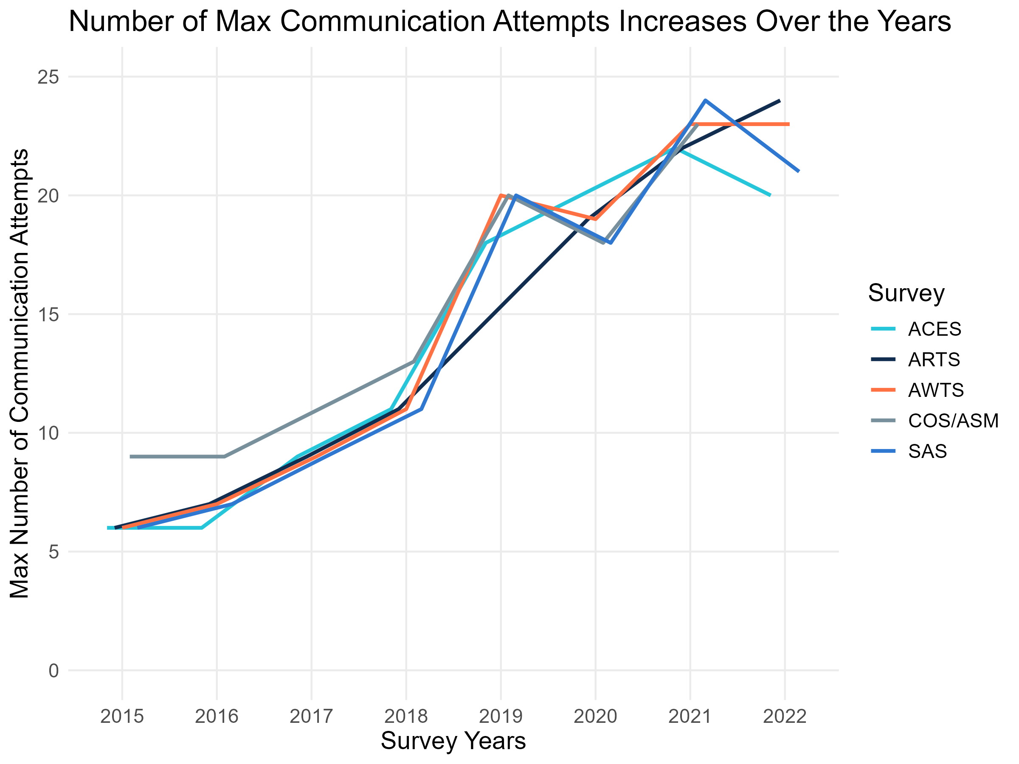
Exploratory Analysis: Communication Over the Years
Across surveys, the number of maximum contact attempts have tripled between survey years 2015-2022.
Notable changes in communication strategies over time include:
Introduction of email and robocalls as contact methods
Introduction of Undeliverable as Addressed (UAA) mailings and Unexpired Extension Requests (UER) emails as specific survey communication messages
Notes:
KL
Day of Week Analysis:
76% of initial emails are sent on a Thursday
55% of DDR emails are sent on a Tuesday
First follow-up email is spread across the work week but second and third FU email mostly occur on Tuesday

Slide 4
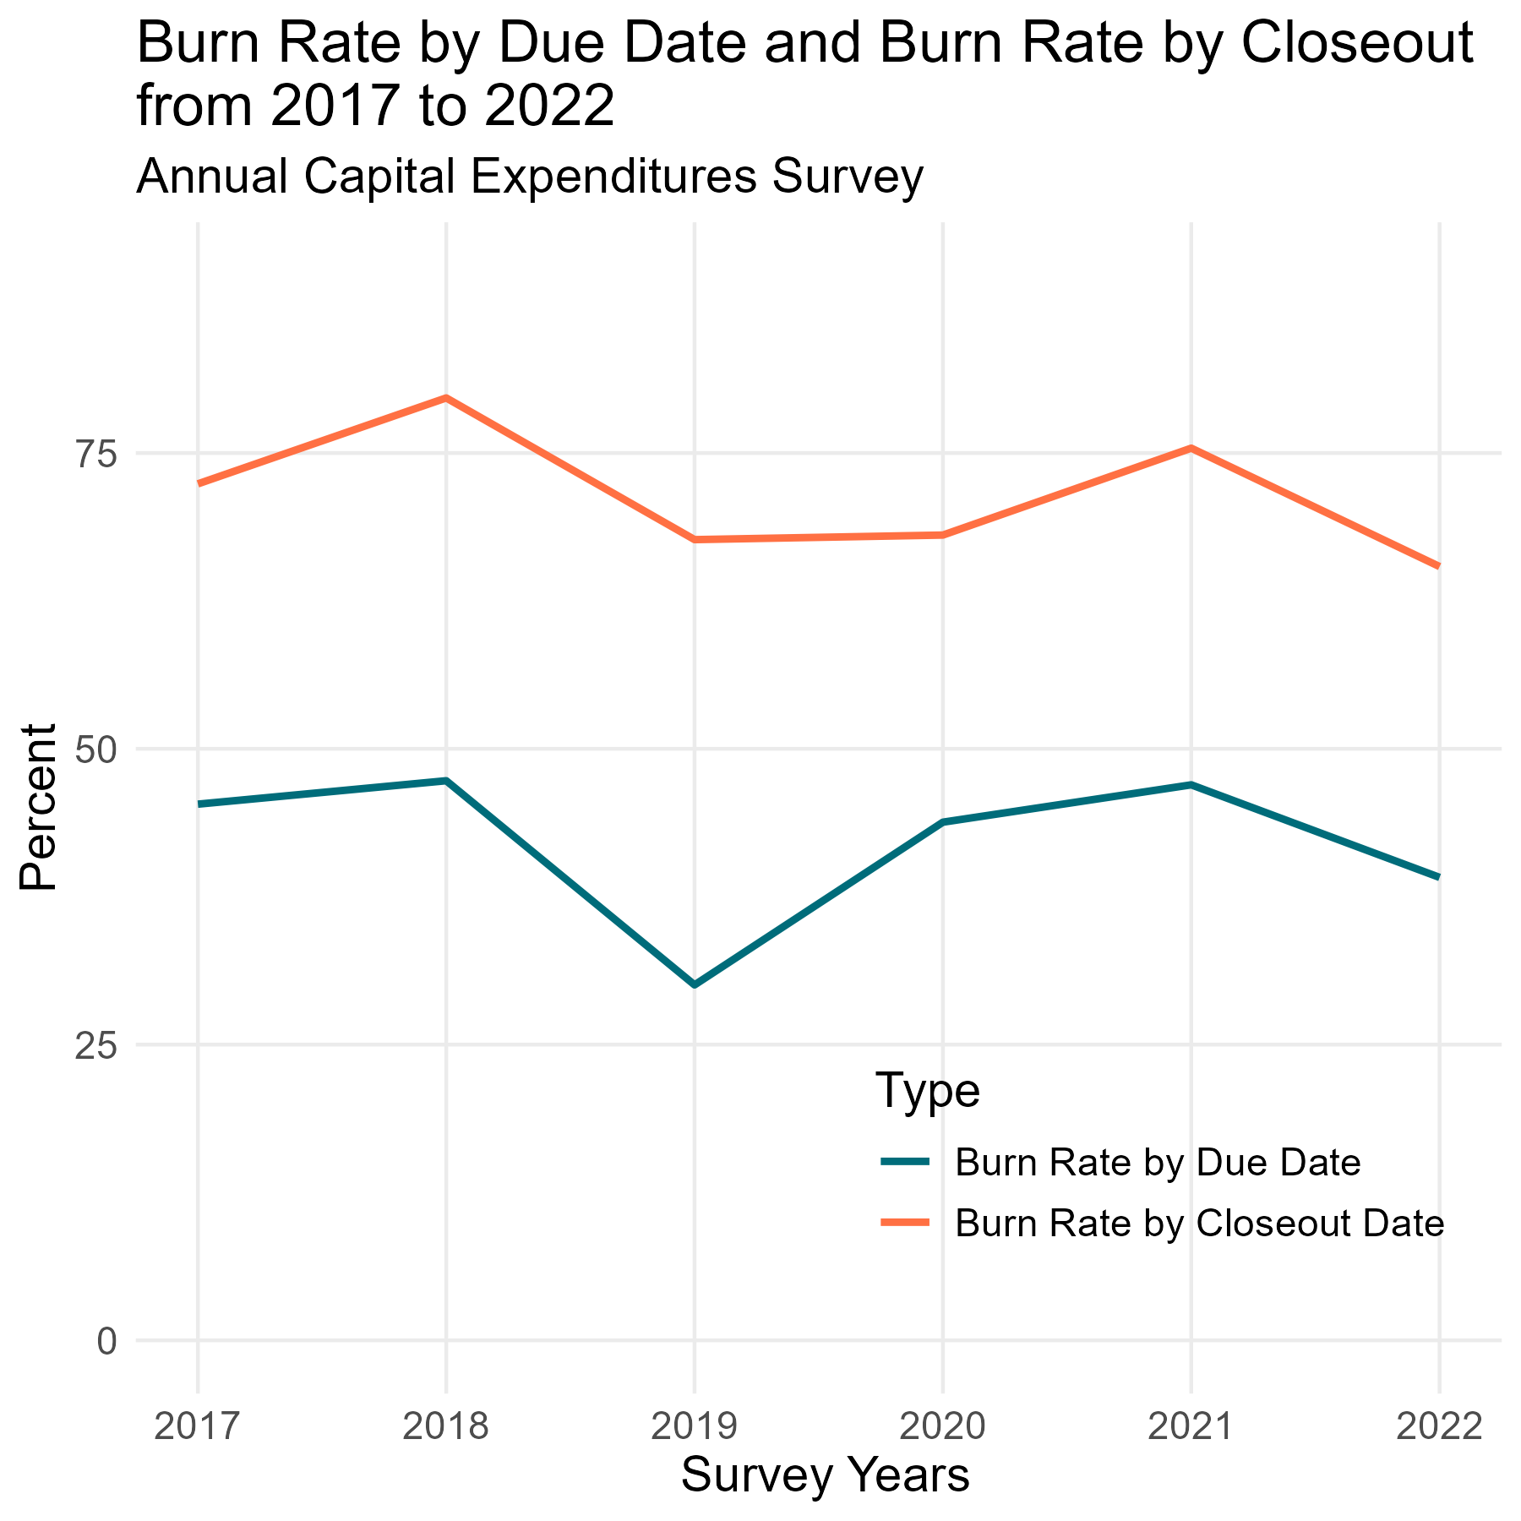
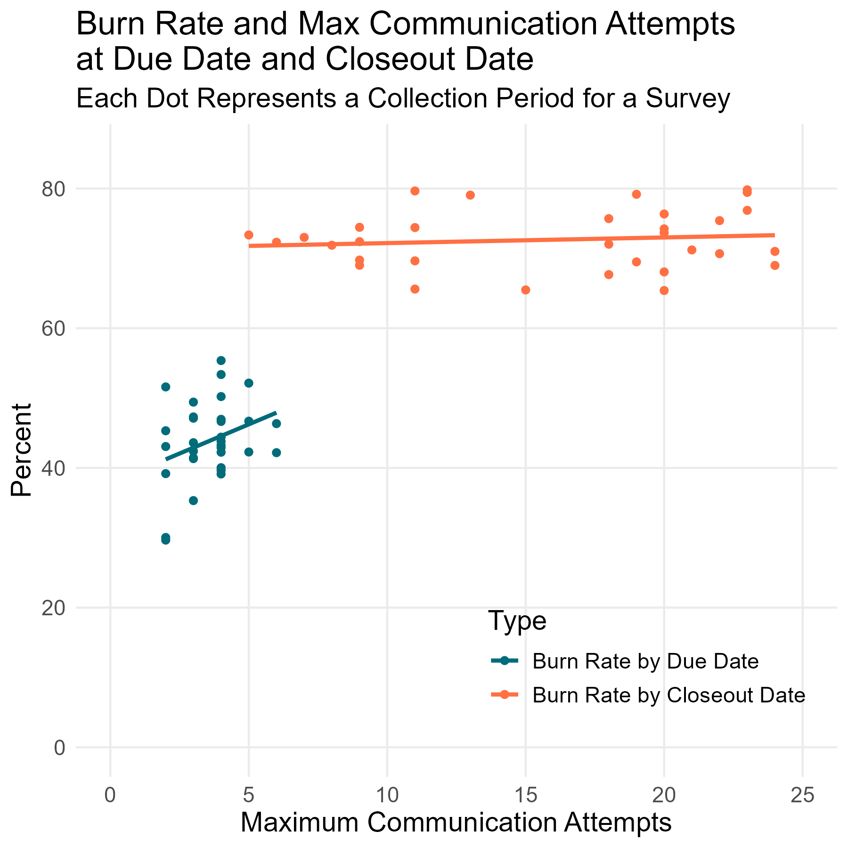
Exploratory Analysis: Respondent Engagement (Burn Rate) Over Time
Notes:
HW
Correlation between increase in survey communication efforts (grey bars) and burn rate/early burn rate also varies

Slide 5
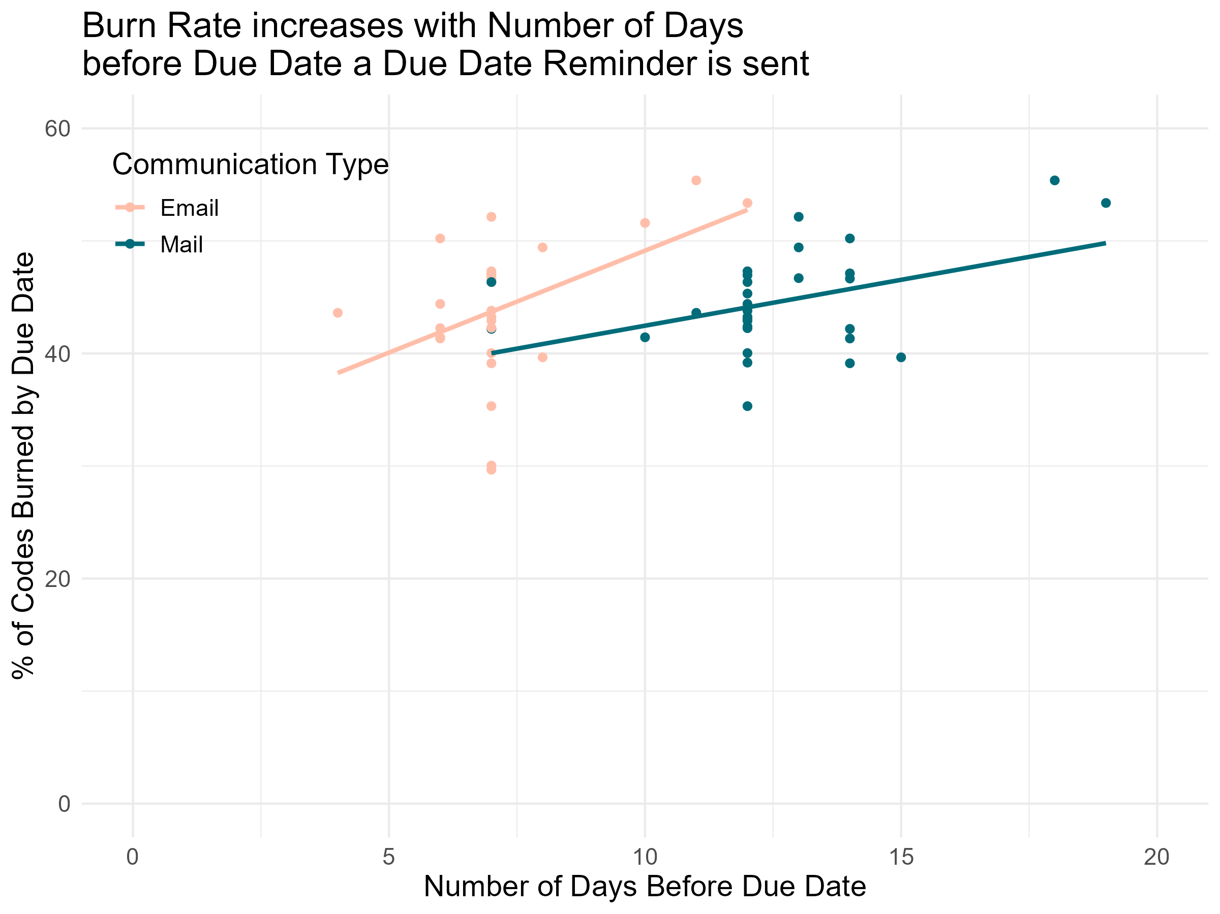
Exploratory Analysis: Due Date Reminder Timing
The number of days before the due date a due date reminder (DDR) is sent is positively correlated with the burn rate.
This indicates that more people may burn their codes when the due date reminder is sent earlier.
Notes:
HW

Slide 6
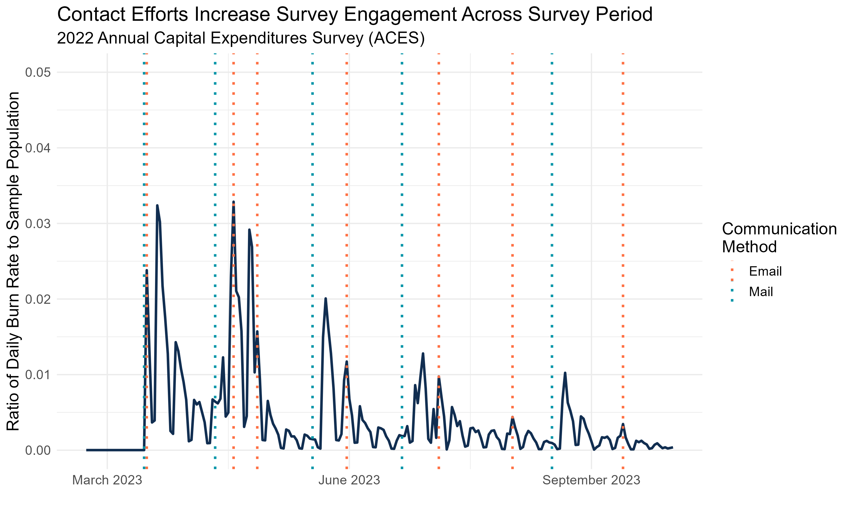
Exploratory Analysis: Contact Efforts and Burn Rate
Over the course of a collection period, we confirmed that contact efforts correspond to an increase in businesses using their authentication code to access a survey (“burning their code”).
Notes:
KL

Slide 7
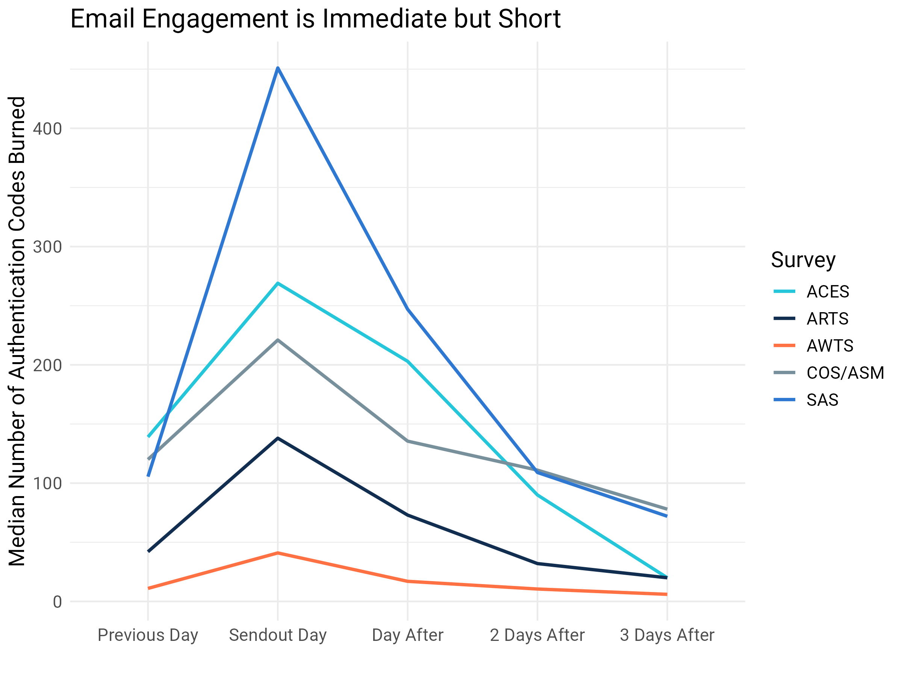
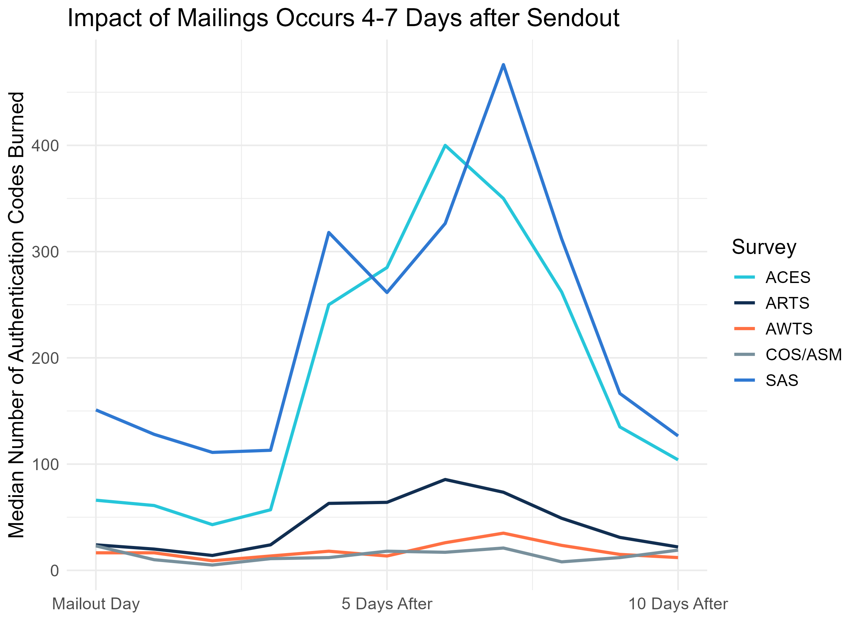
Exploratory Analysis: Email vs. Mail Engagement Shelf Life
The timing and length of effect of different contact methods varies significantly
Notes:
HW

Slide 8
Exploratory Analysis Complications: Overlapping Communications
Emails have immediate impact while the impact of mailings is observed days after send out.
When emails and mailings are sent around the same time, it makes it difficult to isolate the impact of one method on authentication code burn rates.
For 182 mailouts sent during survey years 2017-2022:
About half of mailouts had at least 1 email sent within 2 weeks of mailing
A quarter of mailouts had at least 1 email sent 3-7 days after mailing (peak activity time)
51%
25%
Notes:
HW

Slide 9
Limitations & Recommendations
Limitations:
Unable to link respondents with communication they received
Unable to model relationship between communication methods and respondent engagement
Recommendations:
Minimize the use of emails in the week following mailouts to better discern the impact that mail specifically has on survey engagement
Maintain historical records for the contact efforts over the statistical period
Store data for the different communication strategies (mail/email/call/robocall) in one parent folder
Notes:
HW
We had wanted to model the relationship between communication outreach and its effect on respondent engagement; however, without being able to clearly link respondents with the communication they received, we were unable to implement these models.
As a result of the available data, modeling was only able to occur at the survey level with a sample size of XX.
Primarily focusing at survey level because unable to link contact efforts with corresponding businesses.
Survey frame has a total sample population of 42, but only 32 complete observations with known authentication code burn rate.

Slide 10



Conclusion
Contact efforts notably increase survey engagement but their windows of engagement vary based on the communication method.
The timing of communications in relation to the survey due date may increase survey engagement as seen through authentication code use; however, more investigation is needed to determine causal effects.
A next step would be to add additional data sources such as outbound call information to understand the effects that calls specifically have on respondent engagement.

Slide 11
THANK YOU!
Special thanks to Melissa Cidade, Stephen Cox, Krysten Mesner, James Burton, Jason Bauer, Shelley Karlsson, Emily Wiley, Elizabeth Love, Keith Michael, Eddie Moy, and Lisa Donaldson for their support this summer.
If you have questions, we can be reached at
hannah.l.wen@census.gov and Katharyn.s.Loweth@census.gov.

